Slide 1
Helmet Integrated Impact Detection System

Slide 2
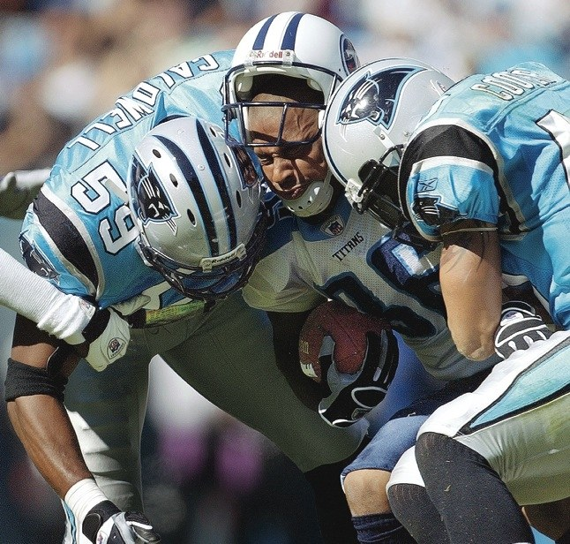
Figure 1. NFL players making helmet on helmet contact

Slide 3
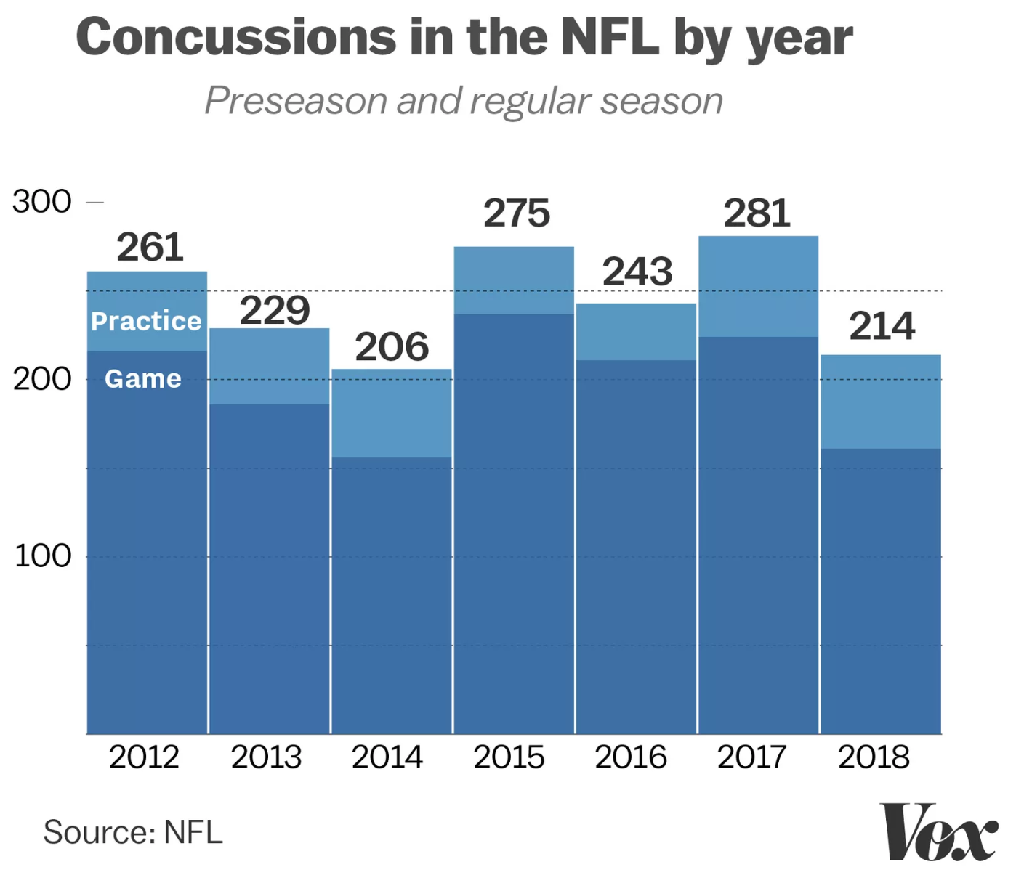
Figure 2. Data shows that multiple concussions occur in NFL games and practices

Slide 4
Overview
The Team
Top-level System Architecture
Technical Objectives
Desired Functionality
Use Cases
Summary

Slide 5




The Team
Jasmine Arrieta
Role: Hardware Design
Emphasis: Electronics
Calvin Lee
Role: Software testing / development
Emphasis: Communications
Rhyan Gonzalez
Role: Hardware Design
Emphasis: Electronics
Socheath Sok
Role: Software Design
Emphasis: BME

Slide 6
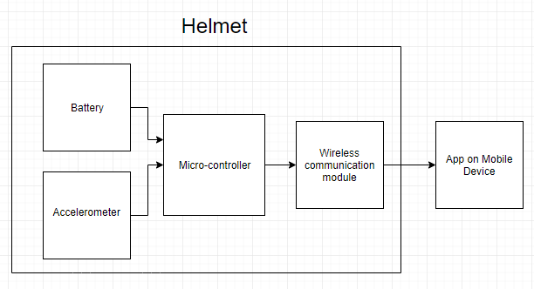
Top-level system architecture
Wireless Communication Module
C
M
Sensor

Slide 7
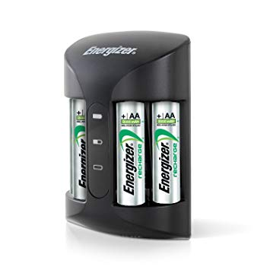
Technical objectives
Seamlessly integrate the sensor into the helmet
Measure impacts between +/- 200 G force
Communication range of at least 50 meters
Powered by rechargeable batteries

Slide 8
Desired functionality
Measure collisions to the helmet
Transmit the data collected from the helmet wirelessly to an app
Send an alert on the app when a helmet collision exceeds a certain threshold
Display a history of impact data over a selected period of time

Slide 9
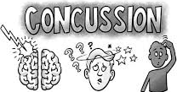
Use Cases
Helmet
Football players of any level playing games and practices
App
Coaches and physicians

Slide 10
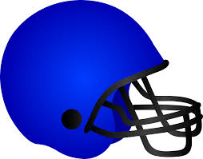


Summary
HIIDS to designed for football players and coaches to detect head impacts to help diagnose possible concussions

Slide 11
References
Marklesparklesports. “Are the NFL Rules Getting Too Soft?” Markle Sparkle Sports, Figure 1, 21 Aug. 2018, https://marklesparklesports.com/2018/08/20/are-the-nfl-rules-getting-too-soft/
Resnick, Brian. “What a Lifetime of Playing Football Can Do to the Human Brain.” Vox, Vox, Figure 2, 4 Feb. 2019, www.vox.com/science-and-health/2018/2/2/16956440/super-bowl-2019-concussion-symptoms-cte-football-nfl-brain-damage-youth.

